Slide 1

FINAL PROJECT - DATA VISUALISATION
GROUP 1
SUBJECT – DATA ANALYTICS
COURSE INSTRUCTOR: KIRTI DHIR
MEMBERS:
NIKHILA ELANGOVAN
SAGARIKA SURESH KALYANKAR
KRISHNA VIJAY RAMAYI VADAKEYIL

Slide 2
TABLE OF CONTENT
Introduction & Problem Statement
Data Pre-Processing
Exploratory Data Analysis
Data Visualization
Predictive Model & Discussion / Analysis
Presentation Title

Slide 3

INTRODUCTION & PROBLEM STATEMENT
We have selected a dataset from the music industry, it it comprises 980 classic hits from the 1990s, featuring 536 different artists. that focuses on danceability, energy, and loudness to examine the ways in which these factors influence a song's attractiveness.
To identify trends that can assist producers and musicians in creating music that resonates with listeners, we combine our passion for music with statistical analysis.

Slide 4
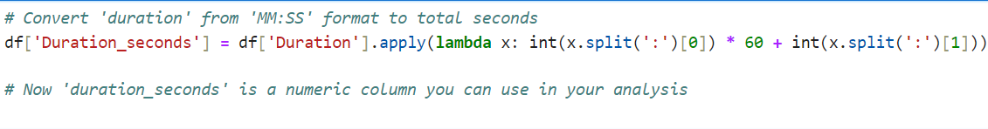
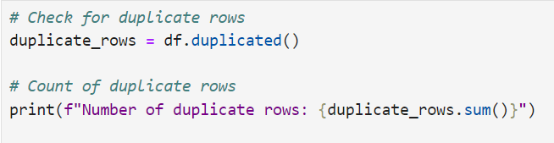
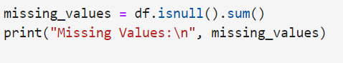
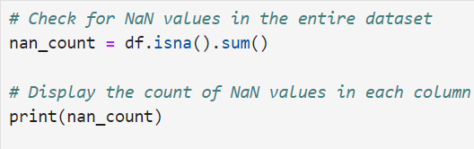
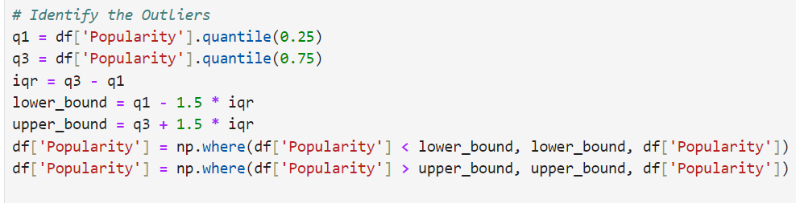
DATA PRE-PROCESSING

Slide 5
DATA PRE-PROCESSING
Convert Duration: Transformed the Duration column from MM:SS format to total seconds.
Identify Duplicates: Checked for and counted duplicate rows in the dataset.
Find Missing Values: Identified and counted missing values in each column.
Detect NaN Values: Counted NaN values across the entire dataset.
Handle Outliers: Adjusted the Popularity column by capping outliers using the IQR method.

Slide 6
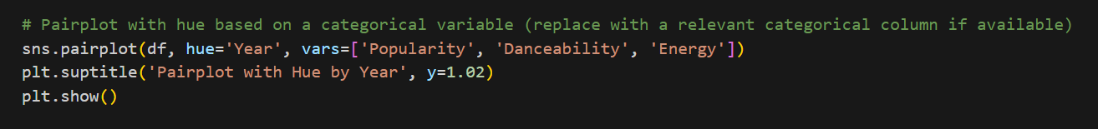
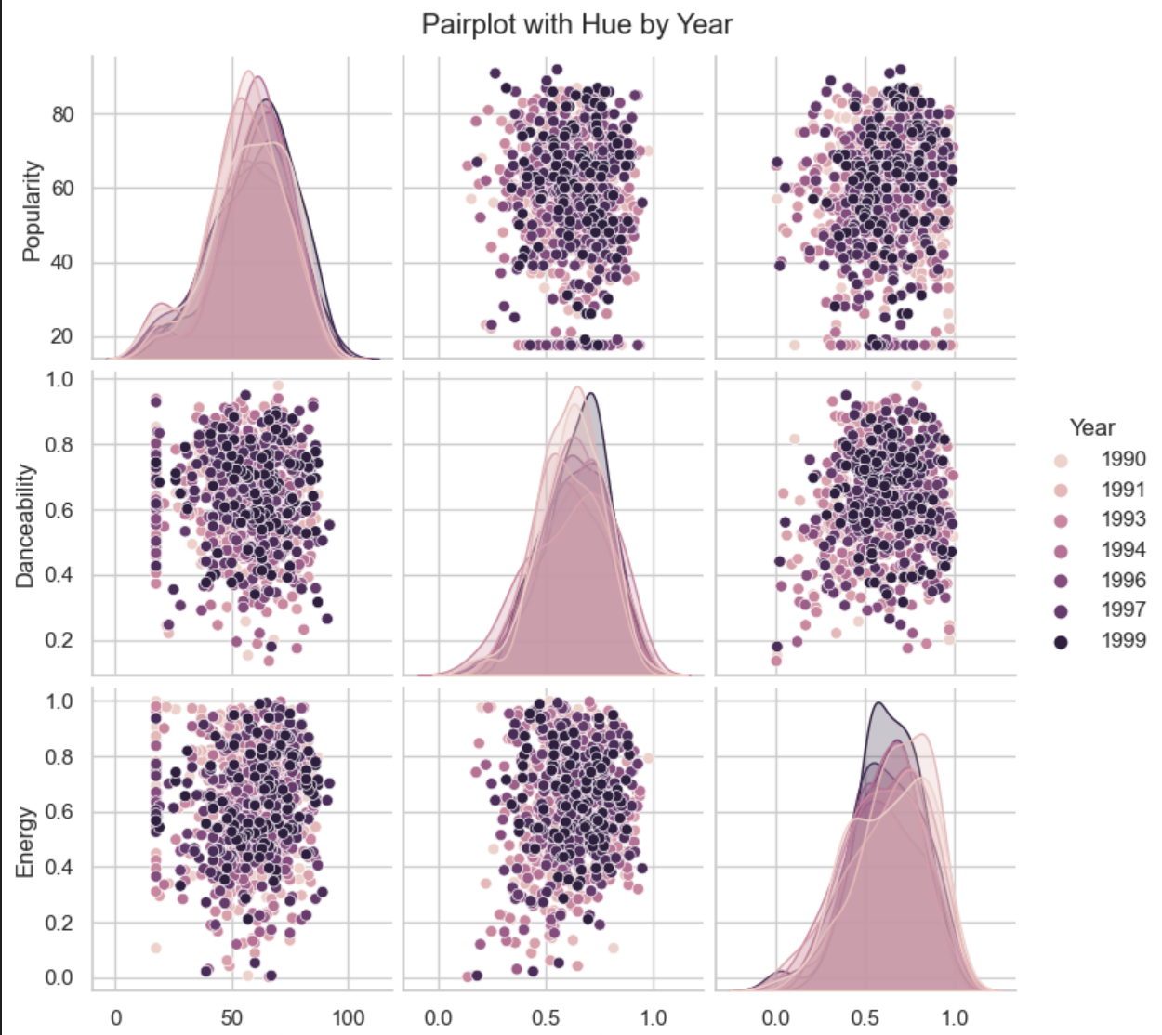
EXPLORATORY DATA ANALYSIS
h
Pairplot Overview: Displays relationships and distributions of musical features like Popularity, Danceability, and Energy from 1990 to 1999.
Hue by Year: Differentiates data points by year, enhancing trend visibility over the decade.
Diagonal Plots:
Show the distribution of each feature individually over time.
Indicate changes in feature values across years.
Off-Diagonal Scatter Plots:
Reveal correlations between features, segmented by year.
Help identify how pairs of features relate over time.
Insights from Visualization:
Enables analysis of evolving musical preferences and song characteristics.
Provides insights into trends and shifts within the music industry during the 1990s.

Slide 7
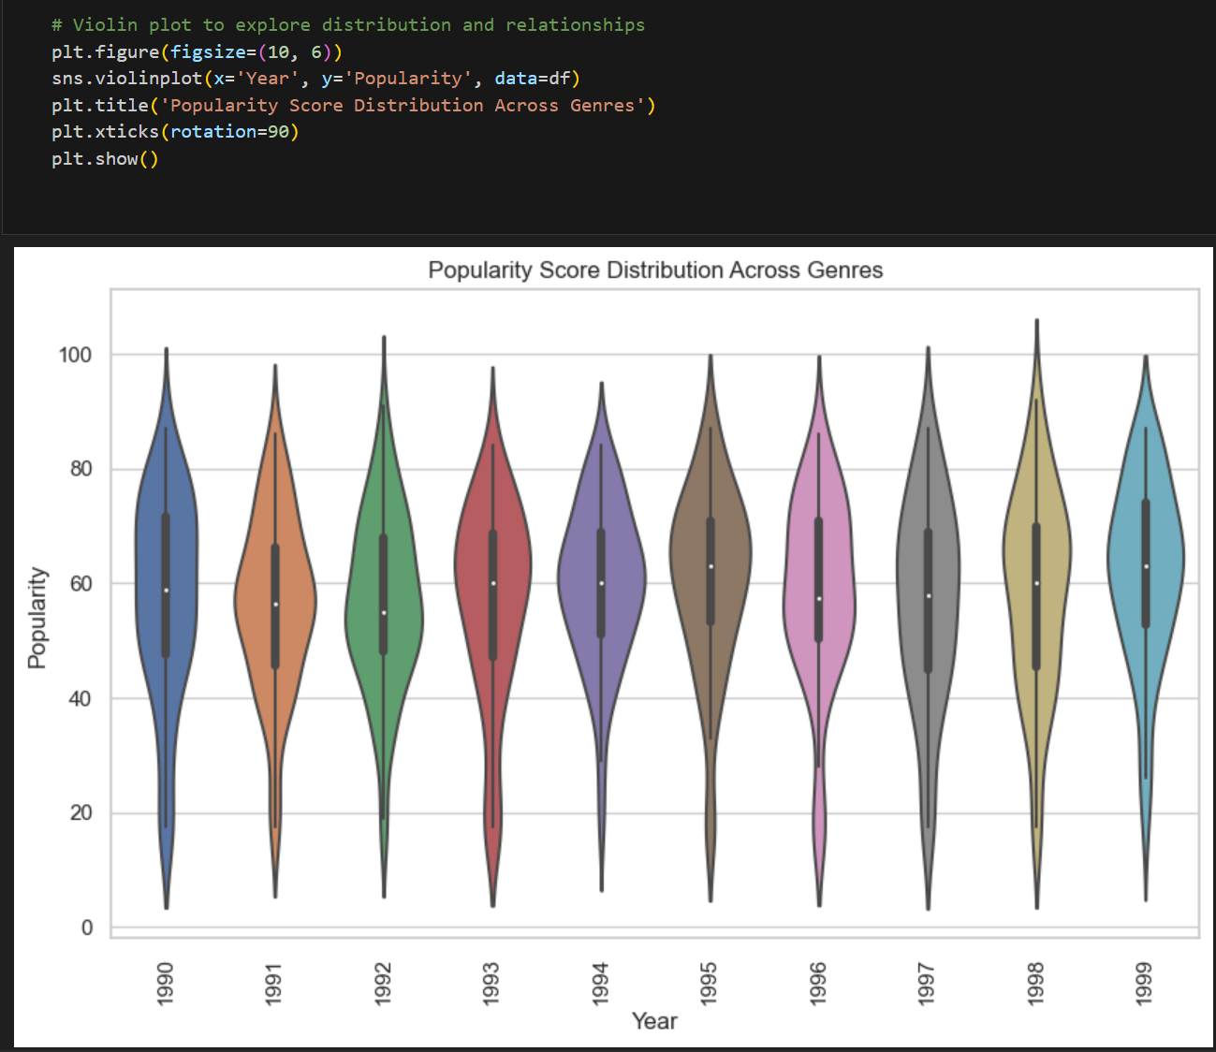
EDA
Plot Design: Utilizes distinct colors to represent each year from 1990 to 1999, showing popularity score distributions through violin plots.
Density Indication: Each violin's width reflects the density of songs' popularity scores, with wider areas indicating a higher concentration of songs.
Annual Trends: Individual violins for each year illustrate changes and trends in the popularity of songs over the decade.
Analytical Value: Offers insights into the variations and shifts in song popularity, aiding in the analysis of historical trends in the music industry.

Slide 8
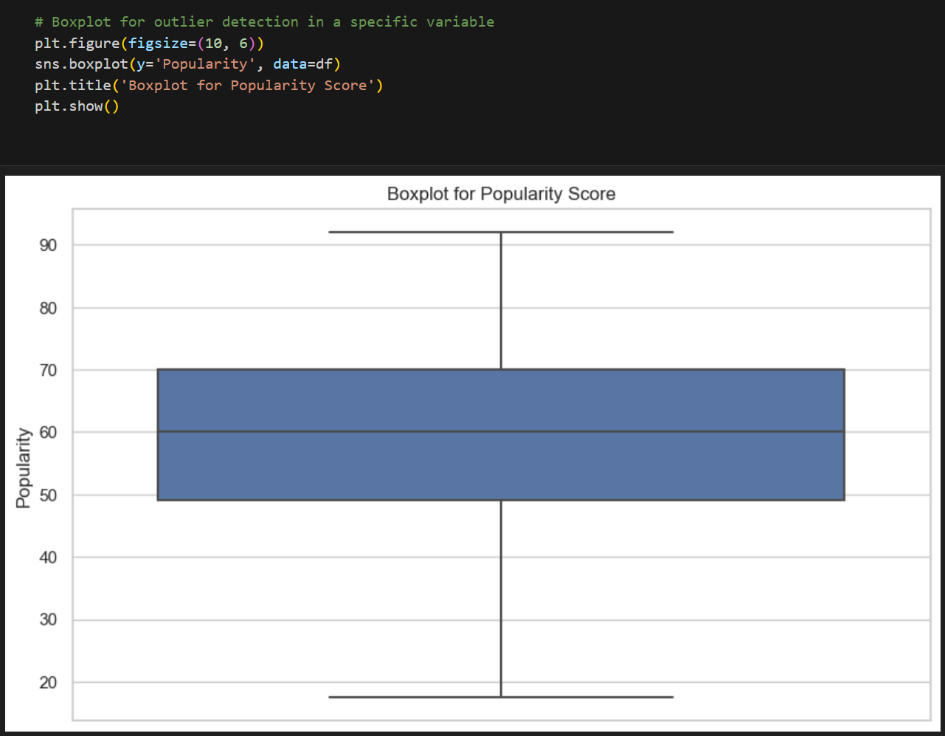
EDA
Boxplot Overview: Displays the distribution of popularity scores for tracks, emphasizing the median, interquartile range (IQR), and total range.
Median Representation: A line within the box marks the median popularity score, indicating the central value of the dataset.
Interquartile Range: The width of the box represents the IQR, showing that most tracks have closely clustered popularity scores.
Outlier Detection: Whiskers extending from the box highlight the presence of tracks with popularity scores significantly outside the typical range.
Analytical Utility: Assists in quickly assessing the central tendency, dispersion, and outliers, facilitating deeper analysis and data-driven decision-making.

Slide 9
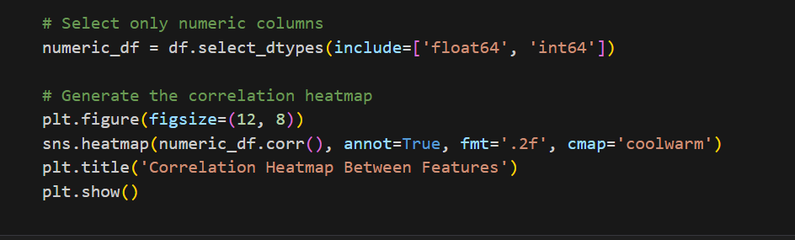
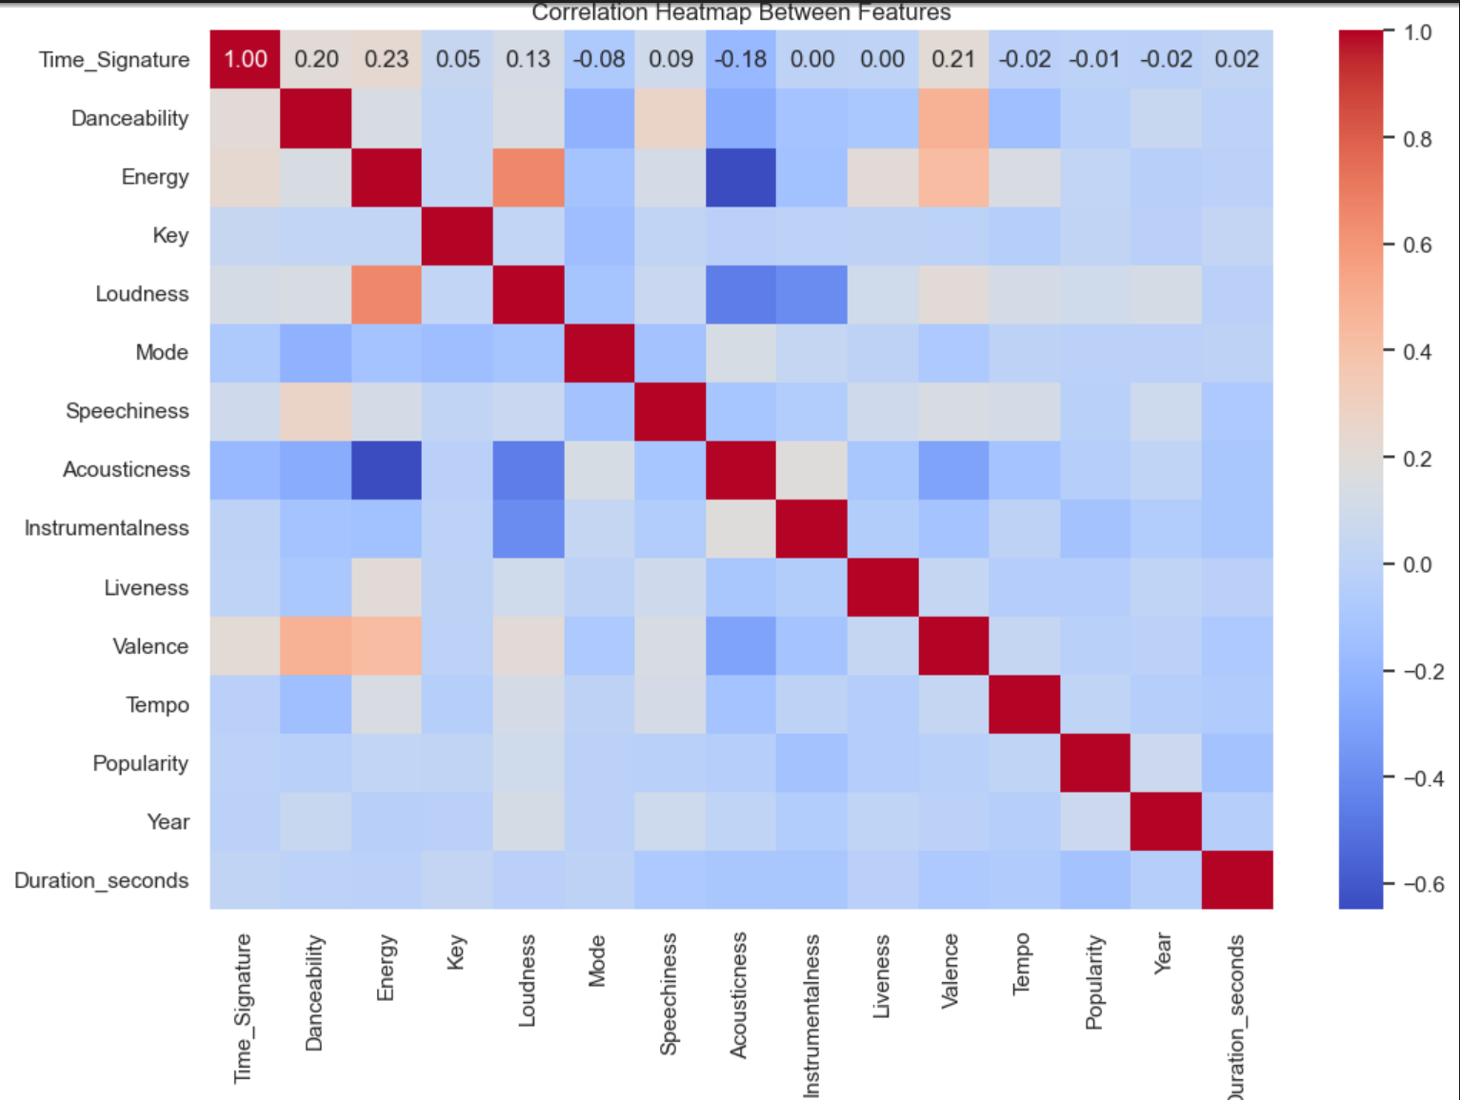
EDA
Color Indicators: Uses red to show positive correlations and blue for negative correlations between musical features.
Key Positive Relationship: Highlights a strong positive correlation between Danceability and Energy, indicating energetic tracks are often more danceable.
Significant Negative Correlation: Demonstrates that louder tracks tend to be less acoustic, emphasizing a negative correlation between Loudness and Acousticness.
Complex Influence on Popularity: Suggests that Popularity is influenced by a complex mix of features, lacking strong direct correlations with other characteristics.

Slide 10
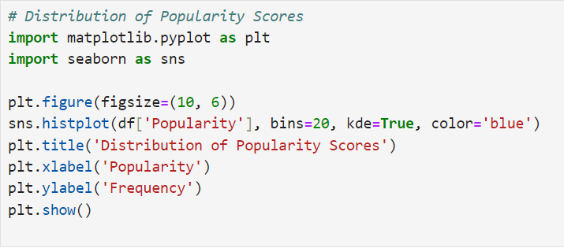

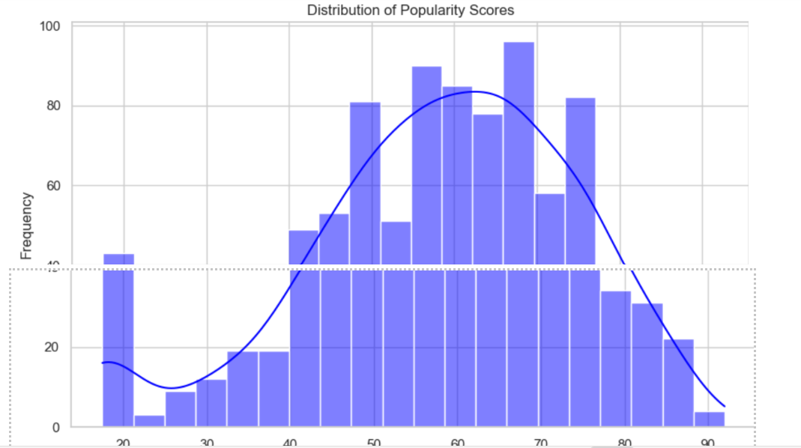
VISUALISATIONS
1. Analysing distribution of Popularity Scores
Insights
The histogram shows the distribution of popularity ratings; most songs fall between frequency points 50 and 70, which indicate the highest frequency.
This frequency pattern explains why the majority of songs have an average degree of popularity, while a smaller fraction are exceptionally popular or extremely despised.
By comparing this frequency distribution, we may look at what factors affect these popularity levels and the reasons why some songs stand out more than others.

Slide 11

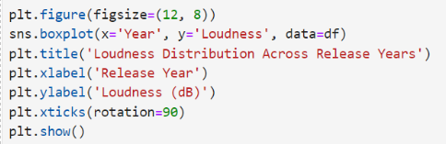
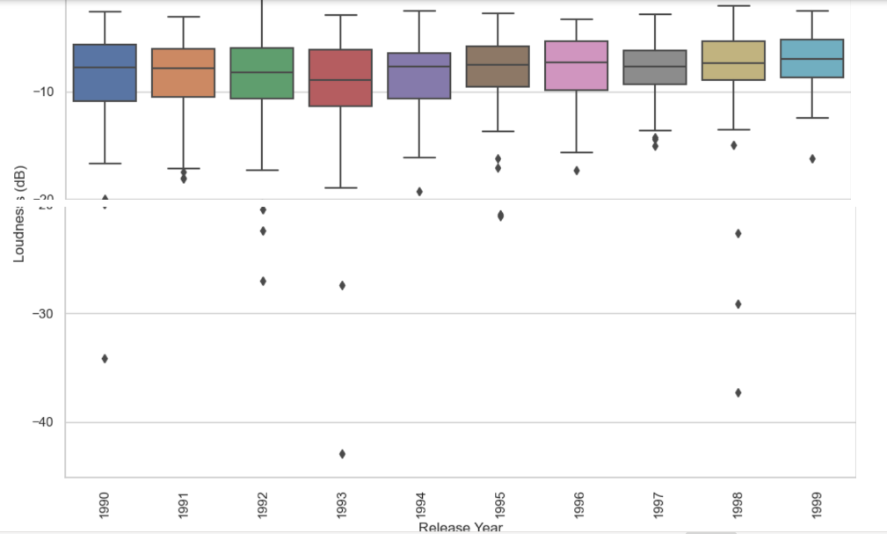
2.How does the loudness of songs vary across different release years? Have there been changes in production loudness over time?
Insights
Using a box plot, we analyzed annual variations in music volume to identify patterns, medians, and outliers.
With occasional outliers and minor fluctuations, song loudness has largely remained constant over time, according to the statistics.
This consistency suggests that other elements, such song popularity, might influence a song's success more than volume.

Slide 12
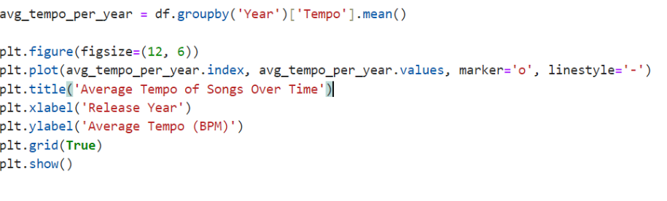
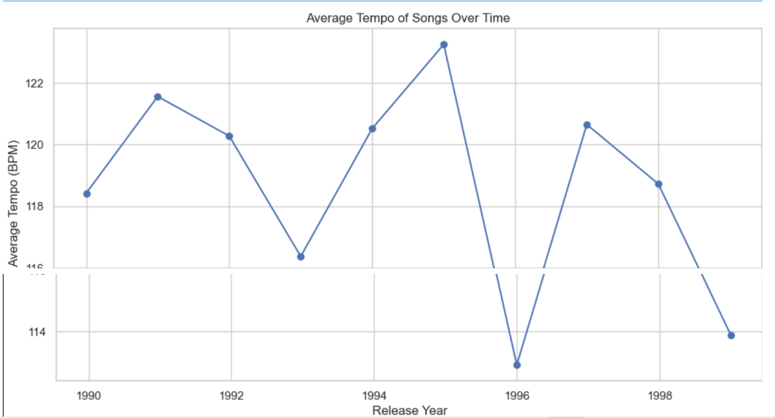
3. How has the average tempo of songs evolved over time? Are songs generally becoming faster or slower?
Insights
Using a line plot to chart changes in tempo over time, we were able to spot trends and ascertain whether tempo affects song popularity.
The average pace of songs has changed over time, reflecting changes in popular music.
During examination of these tempo trend we comprehend how shifting musical tastes impact a song's commercial success and to determine what aspects of a song's timeless appeal.
During early 1990's we can see a decrease in tempo but by the mid of the decade they reaches to high scores.

Slide 13
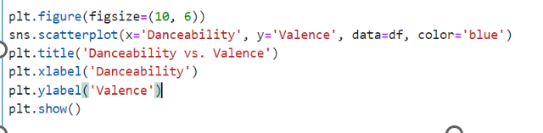
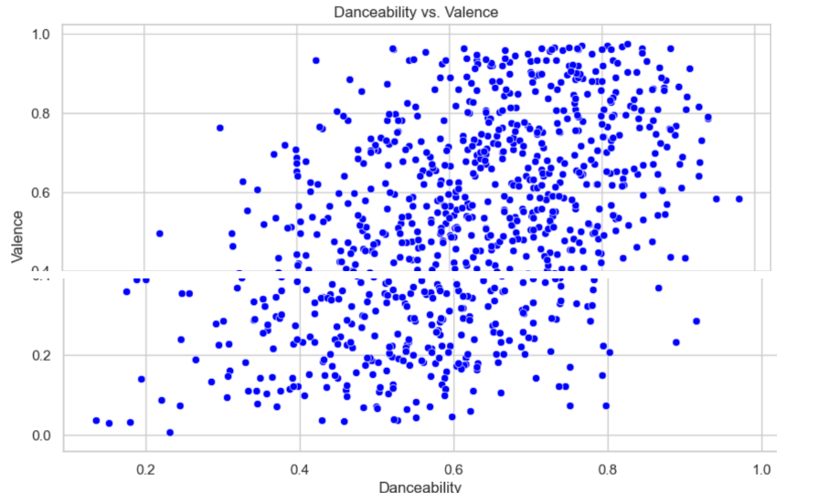
4. Is there a relationship between danceability and valence (positivity)? Are more danceable songs generally more positive?
Insights
To find out if a song's mood affects its popularity, we used a scatter plot to examine the relationship between danceability and valence.
-The data shows that most danceable songs have a positive valence (danceability 0.4–0.8), suggesting that upbeat and happy songs are likely more danceable.
Knowing this relationship helps us to understand how a song's mood might affect its popularity and success.

Slide 14
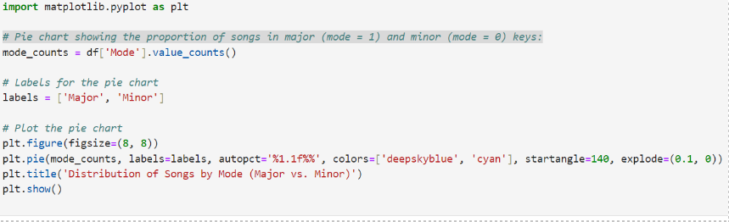
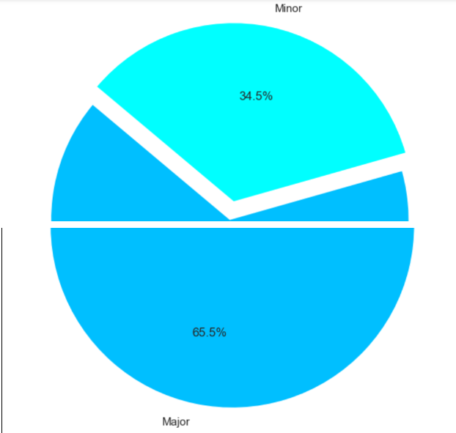
5.Analyse distribution of songs by Modes
Insights
We created a pie chart to help show how song popularity might be impacted by the distribution of songs in major and minor keys.
Major keys make up 65.5% of songs, while minor keys make up 34.5%, according to the statistics.
This implies that major keys are used more often, which could affect a song's appeal and level of popularity. With greater understanding of this distribution, we can examine how the musical key affects a song's success.

Slide 15

PREDICTIVE ANALYSIS

Slide 16
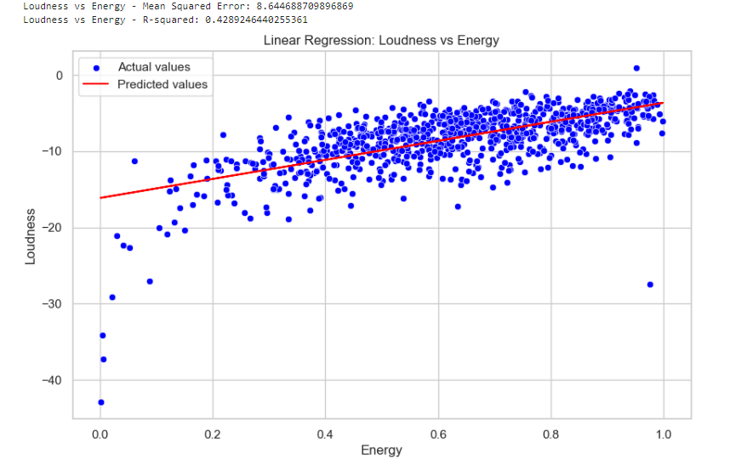
Loudness vs. Energy
Mean Squared Error: 8.644688709896869 R-squared: 0.4289246440255361
The scatter figure illustrates the correlation between Loudness (y-axis) and Energy (x-axis) by fitting a line of linear regression to the data.
The red line indicates the values predicted by the linear regression model, while the blue dots indicate the actual data points.

Slide 17
Positive Slope: The regression line's positive slope suggests that loudness and energy have a positive link. This implies that a song's tendency to get louder goes hand in hand with its energy.
R-squared Value: The energy variable accounts for roughly 42.89% of the variance in loudness, with an R-squared value of 0.4289. This points to a moderate relationship, while energy has a significant influence on loudness, loudness is also influenced by other variables.
Mean Squared Error (MSE): MSE is 8.644. This shows the average squared variance between the model-predicted Loudness values and the actual ones. Although the model is useful, it is not flawless, as indicated by the number, which represents the error margin in the model's predictions.
Summary The positive association suggests that louder music tends to be greater in energy. The moderate R-squared number indicates that additional factors are likely at work in addition to Energy, which is important in determining Loudness.

Slide 18
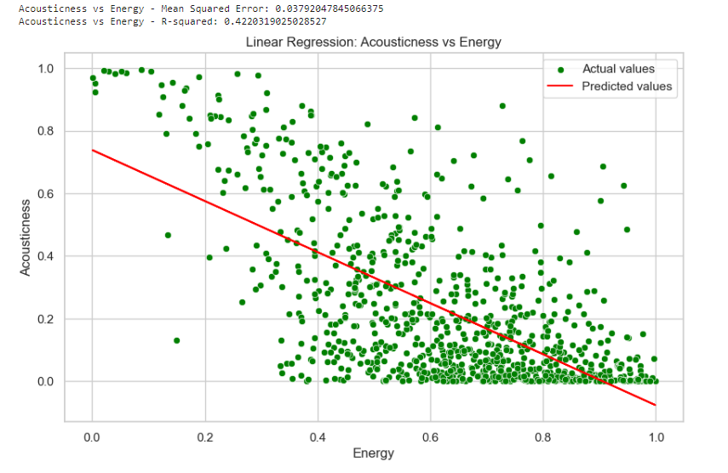
Energy vs. Acousticity
Mean Squared Error: 0.03792047845066375 R-squared: 0.4220319025028527
The scatter plot depicts the correlation between Acousticness (y-axis) and Energy (x-axis) using a linear regression line. The analysis is done as follows.
The red line indicates the values predicted by the linear regression model, while the green dots indicate the actual data points.

Slide 19
Interpretation
Positive Slope: It can be observed that there is a negative association between Acousticness and Energy based on the regression line's negative slope. According to this, a song's acoustic qualities—such as its organic, raw sound—tend to deteriorate as its intensity rises.
R-squared Value: Approximately 42.20% of the variance in Acousticness can be explained by the Energy variable, according to the R-squared value of 0.4220. Comparable to the plot of loudness vs. energy, this connection is similarly modest.
Mean Squared Error (MSE): With an MSE of 0.0379, which is low, the model's average forecast accuracy is pretty close to the real Acousticness values.
Summary
In conclusion, it appears that songs with more energy tend to be less acoustic due to the negative association, which might be explained by the fact that higher energy songs typically feature more processed or electronic sounds. Although there are additional elements that affect acoustic characteristics, the R-squared value indicates that energy plays a substantial role in defining acousticness.

Slide 20

ANALYSIS & RECOMMENDATION

Slide 21
1. Mode Distribution: The majority of songs (65.5%) are in a major mode, indicating a taste for upbeat and more happier music. Recommendation : Use minor mode for more contemplative or emotional themes; concentrate on major mode songs for upbeat content. 2. Tempo Trends: Songs' energy is affected by alterations in tempo. It is advised to match the pace to the goal of the campaign Recommedation: slower tempos for thoughtful branding, quicker tempos for enthusiastic advertisements. 3. Danceability vs. Valence: Dancing can occur in songs with different degrees of positivity. Recommendation: Choose tracks that have a balance between danceability and suitable valence levels for maximum participation.
4. Loudness Trends: Loudness varies by release year, which has an impact on the listening experience.
Recommendation: It's advised to standardize volume levels between songs to create a unified sound design.
5. Popularity Distribution: To appeal to a wide audience, concentrate on songs that are in the peak popularity area, but mix in a few lesser-known songs for diversity.

Slide 22




THANK YOU!

